Slide 1


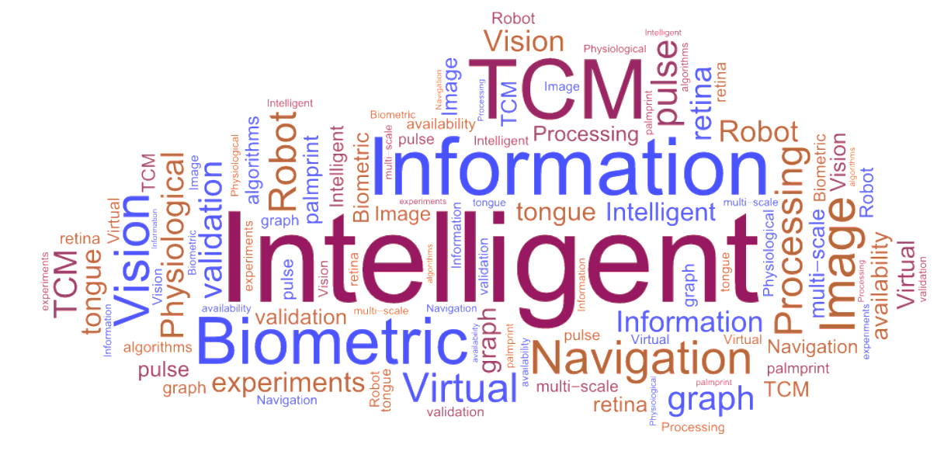
感知计算研究中心

Slide 2
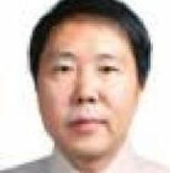
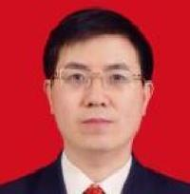
中心成员
>>
王宽全 教授
中心主任
邬向前教授
国家首批“西蒙学者”
曾任哈工大计算机科学与技术学院副院长、哈工大（威海）计算机科学与技术学院院长、计算机科学与技术国家级实验教学示范中心主任
长江学者
哈尔滨工业大学计算学部副主任
黑龙江省视听觉认知计算重点实验室主任
教授
2人
副教授
3人
讲师
1人
博士生
20+
硕士生
20+

Slide 3
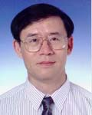
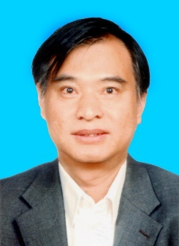
客座教授
>>
张大鹏教授
张恒贵教授
IEEE Fellow, IAPR Fellow
Croucher Innovation Award
International Journal of Image and Graphics主编
国家特聘专家
曼彻斯特大学讲席教授
Biological Reviews 编委
3
Associate
Professors
20+
Ph.D
Students
30+
Master
Students
4
Professors
3
Post-doc

Slide 4

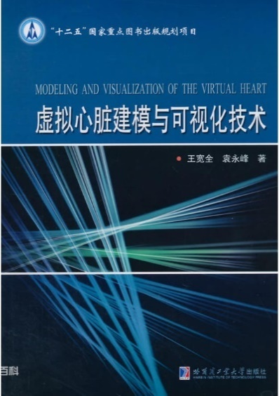
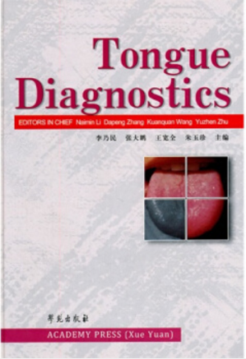
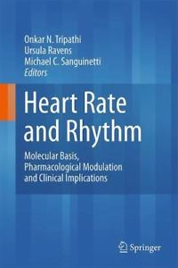
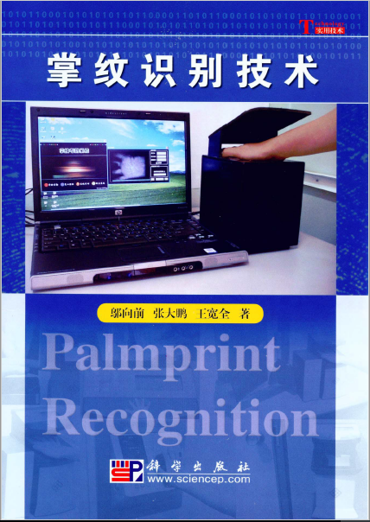
专著出版
>>
The Virtual Heart Modelling and Visualization Technology
K. Wang et al.
HIT Press 2014
Tongue Diagnostics
K. Wang et al.
Academy Press 2011
Chapter: The Short QT syndrome.
in Heart Rhythm
H. Zhang et al. Springer, 2011
Palmprint Recognition
X. Wu et al.
Science Press, 2006
Notes:
目前研究方向-8个 读一下

Slide 5
研究领域
>>
The World
生物细胞建模--诺贝尔奖
虹膜
识别
掌纹
识别
医学图像处理-深度学习
1990
2010
2013
Our Group
1958-1993
1994
1998
虚拟生理系统建模
生物特征识别
器官的自动分割与重建
Notes:
目前研究方向-8个 读一下

Slide 6
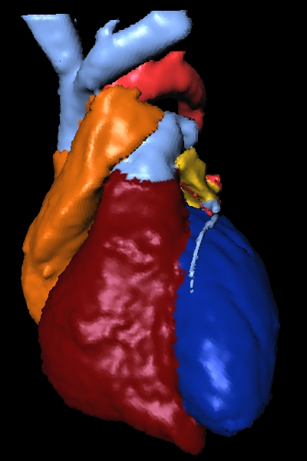
1. 虚拟生理心脏
任务与挑战
e-Heart
Clinical electrophysiology
Basic Research
Arrythmias
/Defibrillation
e-Cardiology
Drug reaction
Drug development
Safety assessment
e-Pharmacology
VR
Virtual design
Training
Virtual Surgery
Notes:
李钦策

Slide 7


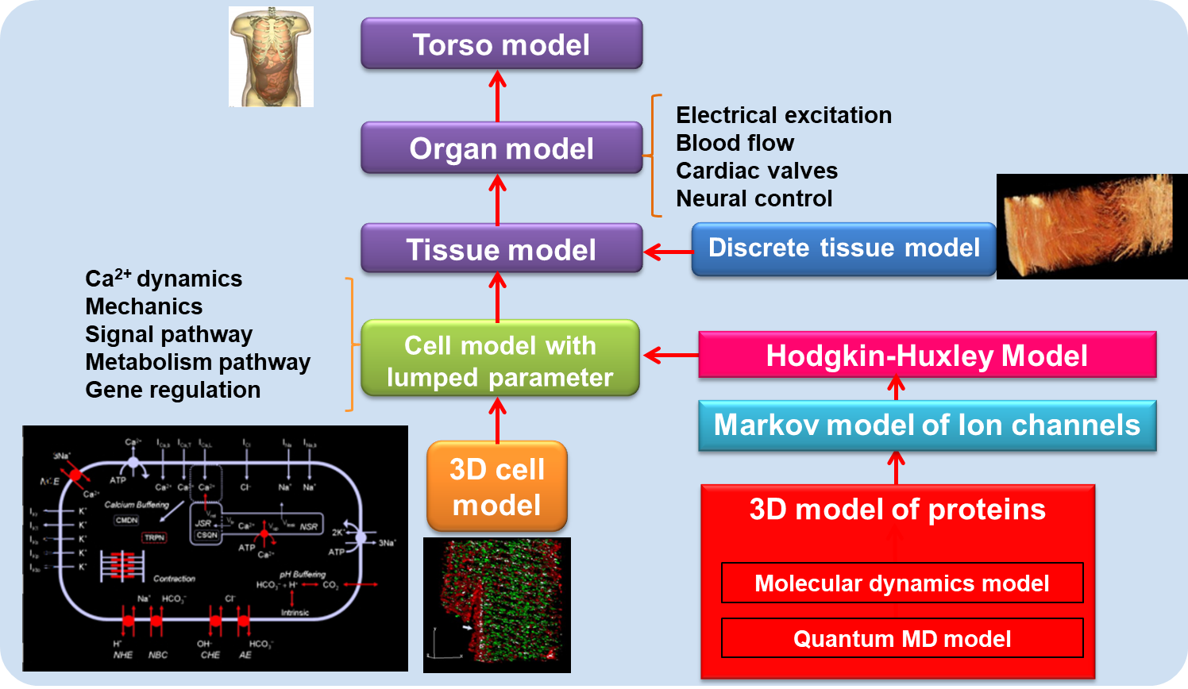
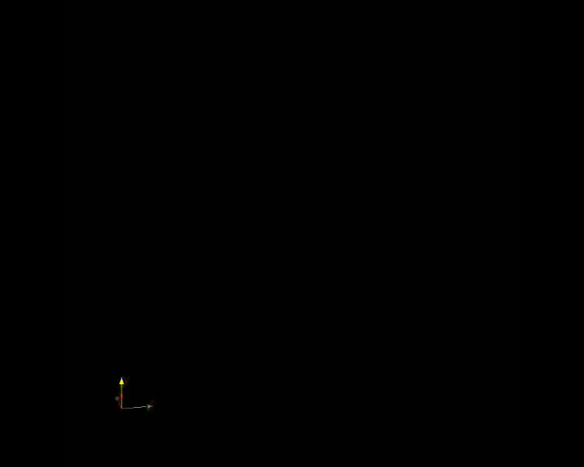
1. 虚拟生理心脏
• 研究目标
Notes:
李钦策

Slide 8
1. 虚拟生理心脏
5年内顶刊论文发表
 | Journals | No.
1 | Frontiers in Physiology | 6
2 | PLoS Computational Biology | 2
3 | Journal of Molecular and Cellular Cardiology | 2
4 | IEEE Journal of Biomedical and Health Informatics | 1
5 | Journal of Physiology | 1
6 | British Journal of Pharmacology | 1
7 | Chaos | 1
8 | BMC Bioinformatics | 1
9 | Image and Vision Computing | 1
10 | Neurocomputing | 1

Slide 9
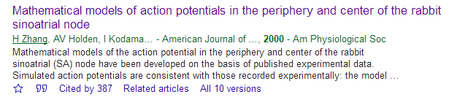
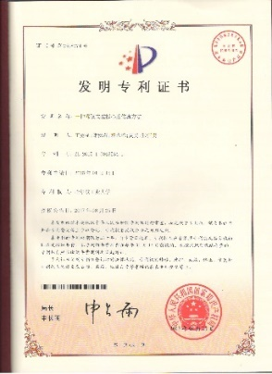
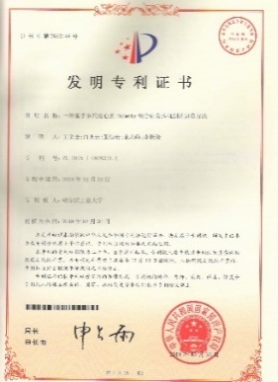
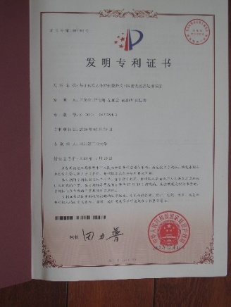
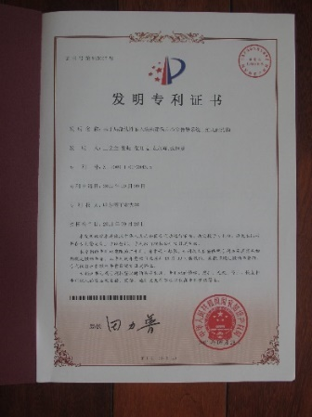
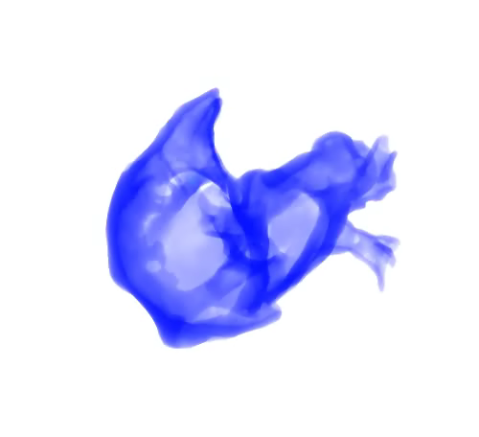
1. 虚拟生理心脏
代表成果（1）
多种细胞模型开发
No. | Cell type | Model | Species | Comments
1 | SA Node | Zhang et al. 2000 | Rabbit | The first SA node model with spatial heterogeneity.
2 | AV Node | Inada et al. 2009 | Mammal | The first and only AV node model.
3 | Purkinje Fiber | Stewart et al. 2010 | Human | Based on detailed experimental data from human.
4 | Atria | Colman et al. 2013 | Generic | The first atrial model with spatial heterogeneity.
Notes:
邬向前

Slide 10
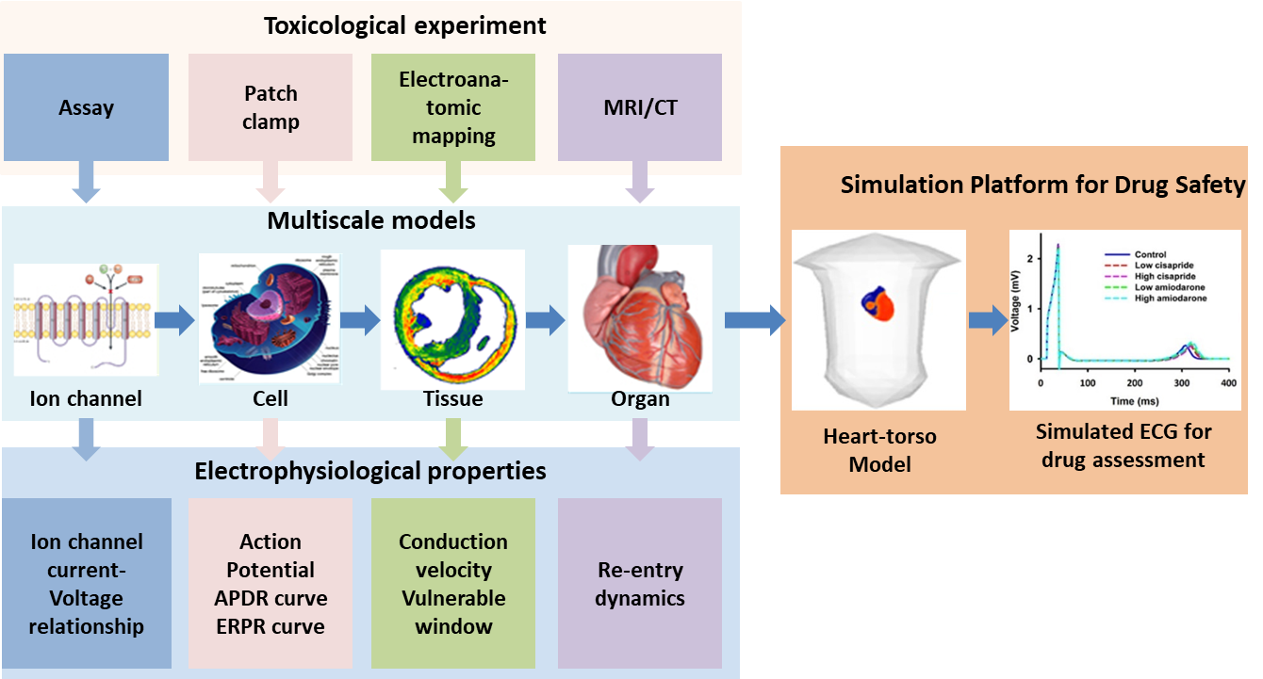
1. 虚拟生理心脏
代表成果（2）
模型的理论预测及药物安全型平台
Computational Prediction ：Role of I_{Na} in association with sick sinus syndrome in 1998.
H. Zhang et al. (1998). “A hypothesis to explain the decline of sinoatrial node function with age", Journal of physiology, 511: pp. 76-77.
Experimental discovery：14 identified Scn5a gene mutations in sick sinus syndrome in the following 10 years.
Lei et al. (2007). Cardiovascular Research 74: 356–365.
1. Yuan, YF et al. The virtual heart as a platform for screening drug cardiotoxicity, British journal of pharmacology，2015.
Notes:
邬向前

Slide 11
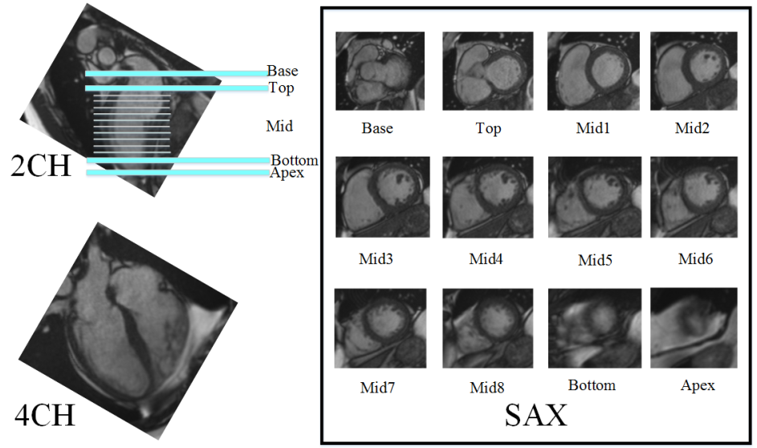
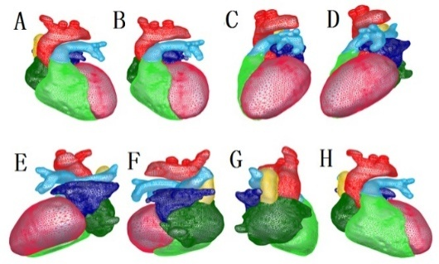
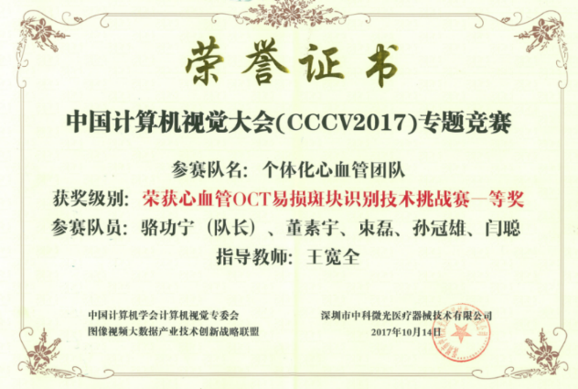
1. 虚拟生理心脏
代表成果（3）
心脏的自动分割与重建
Innovation:
Segmentation algorithms based on various types
of images (CT, MRI, etc.).
3D cardiac model reconstruction and rapid prototyping.
Grants :Supported by the National Key R&D Program:
High-confidence and Strong Intelligence Cardiovascular Treatment Program.
Publication :
1. Luo, G., et al. Multi-views Fusion CNN for Left Ventricular
Volumes Estimation on Cardiac MR Images. IEEE Transactions
on Biomedical Engineering，2017.
2. Zhang, L., et al. A Visualization System for Interactive
Exploration of the Cardiac Anatomy. JOURNAL OF MEDICAL
SYSTEMS 2016.
Notes:
The First prize of blood vessel vulnerable plaque recognition challenge on CCCV 2017.

Slide 12
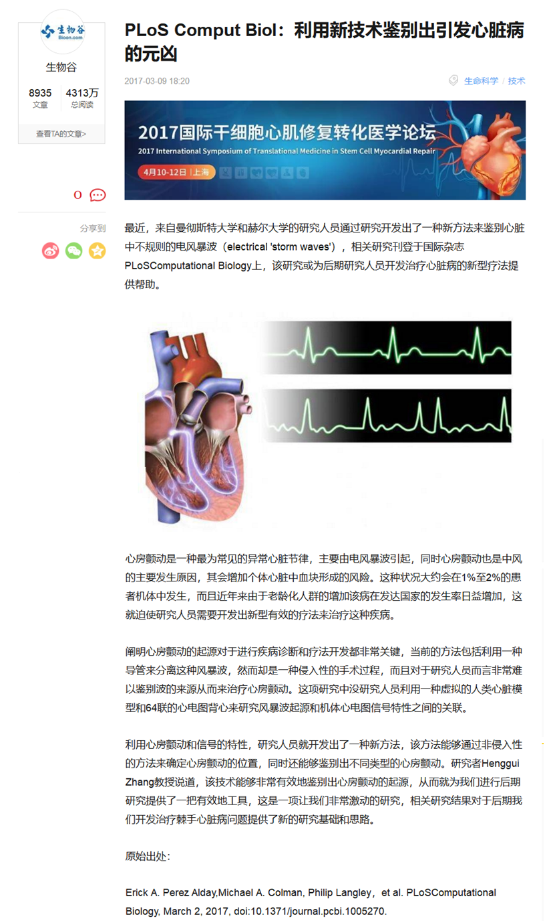
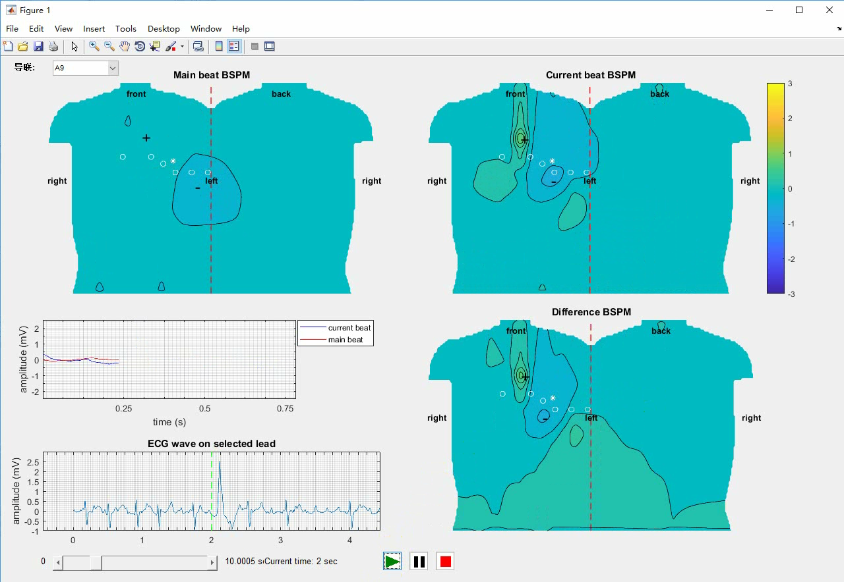
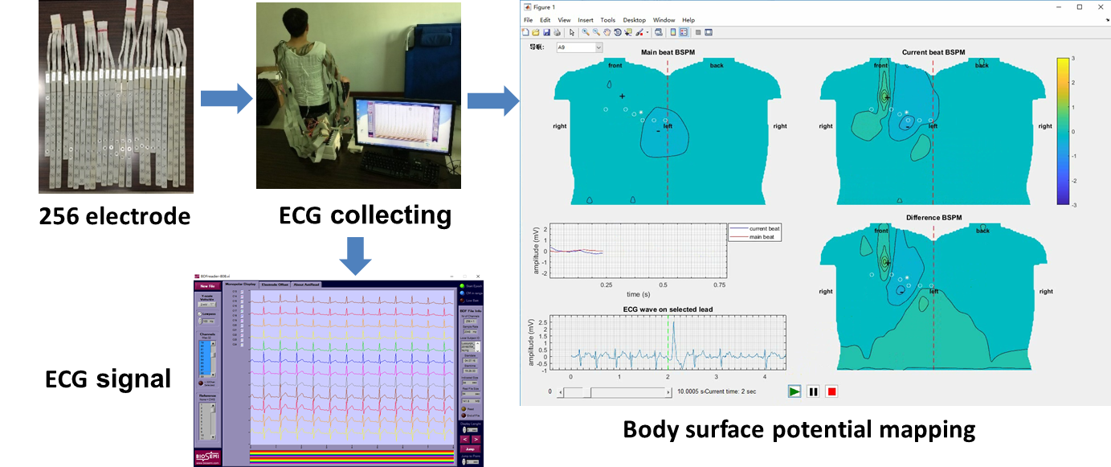

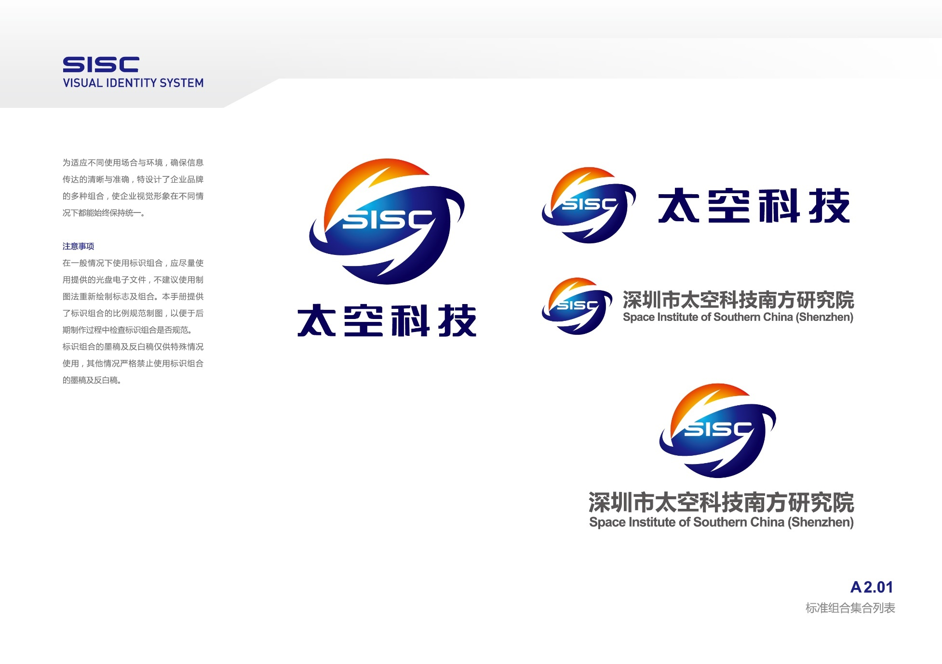
1. 虚拟生理心脏
代表成果（4）
基于体表多导联心电信号反演心脏电活动
Innovation:
The first and only 256-leads ECGi system in China.
Non-invasively Identifying the origin of atrial fibrillation.
Publication :
1. Alday E, et al. Novel non-invasive algorithm to identify the origins of re-entry
and ectopic foci in the atria from 64-lead ECGs: A computational study. PLoS computational biology, 2017.
Notes:
邬向前

Slide 13
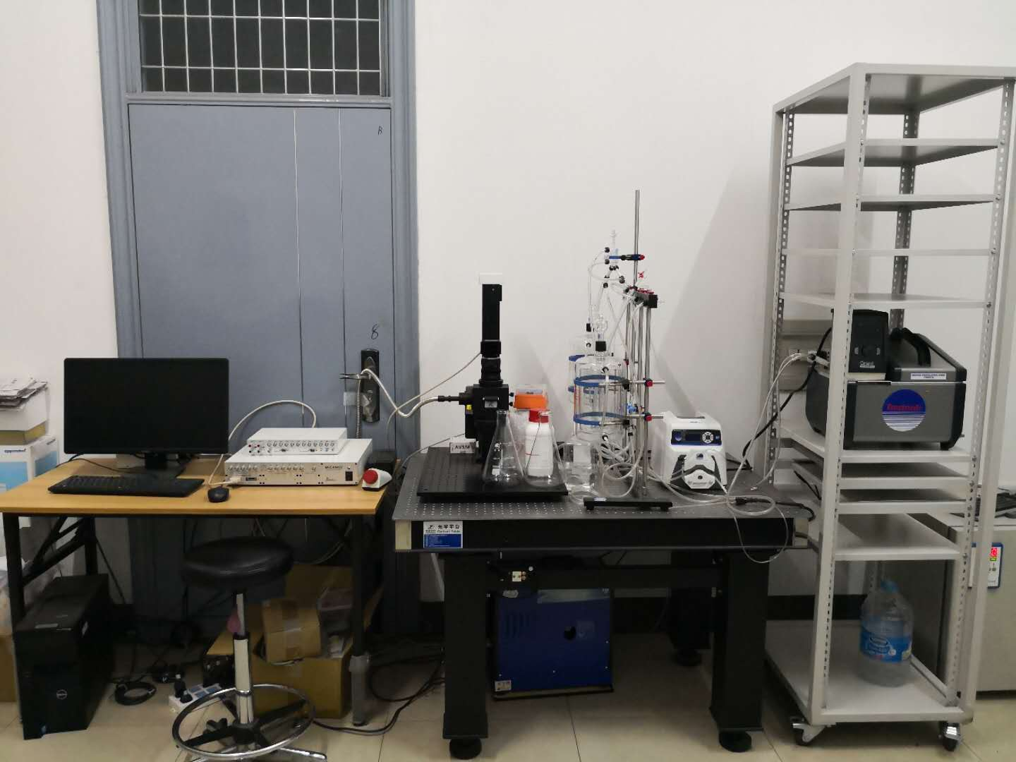
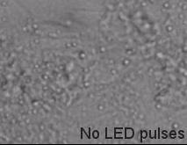
1. 虚拟生理心脏-光遗传学
– The first system of non-invasively optical pacing & mapping in China.
（In Progress）

Slide 14

国际合作
M. Lei,
D. Noble (Oxford,UK)
I. Efimov (Washington, USA)
S. Panfilov
(Ghent, Belgium)
ME Mangoni (Montpellier, France)
EG Lakatta (NIH,
Baltimore, USA),
Y. Kurata (Tottori, Japan),
P. Hunter (Auckland,
New Zealand)
X. Wang
(Sydney, Australia)

Slide 15
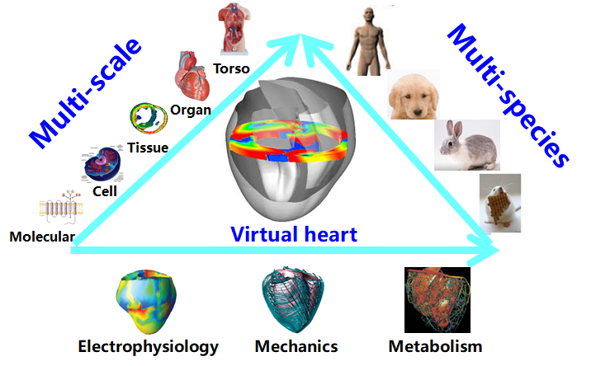

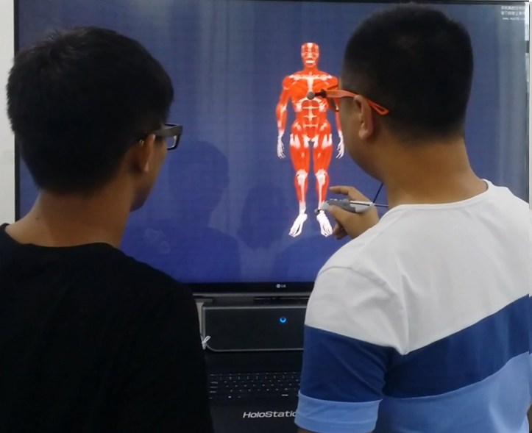
未来研究方向
>>
• Basic Research
• Clinical Applications
• Other Applications
Virtual heart in Electronic Medical Record
Virtual heart in Virtual Reality
Notes:
目前研究方向-8个 读一下

Slide 16
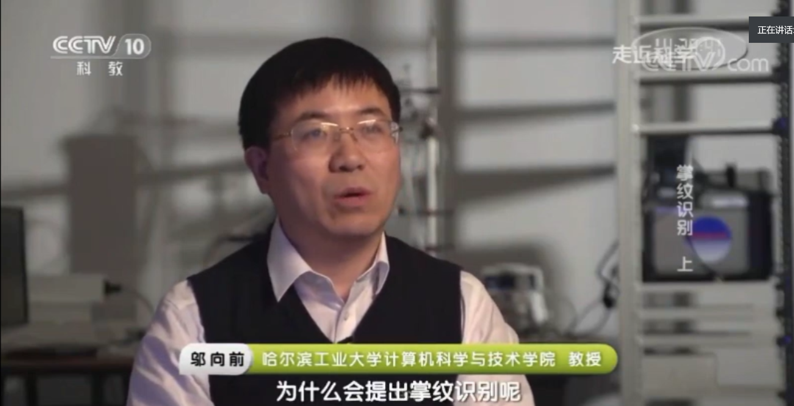
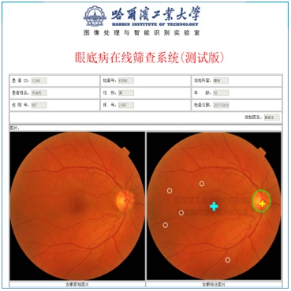
2. 生物特征识别与中医诊疗
任务与挑战
在复杂环境下实现人身份的精确与快速识别.
根据识别的医学特征，尽早地实现病人病情的自动诊断

Slide 17
2. 生物特征识别与中医诊疗
顶刊论文发表情况
 | Journals | No.
1 | IEEE Transactions On Cybernetics | 1
2 | IEEE Trans. On Information Technology In Biomedicine | 2
3 | IEEE Transactions On Biomedical Engineering | 2
4 | IEEE Transactions On Image Processing | 4
5 | IEEE Transactions On Medical Imaging | 1
6 | IEEE Transactions On Cybernetics | 1
7 | IEEE Journal Of Biomedical & Health Informatics | 3
8 | IEEE Computational Intelligence Magazine | 1
9 | IEEE Transactions On Neural Networks & Learning Systems | 1
10 | Expert Systems With Applications | 4
11 | Pattern Recognition | 11
12 | Sensors And Actuators B-Chemical | 1
13 | ACM Computing Surveys | 1

Slide 18
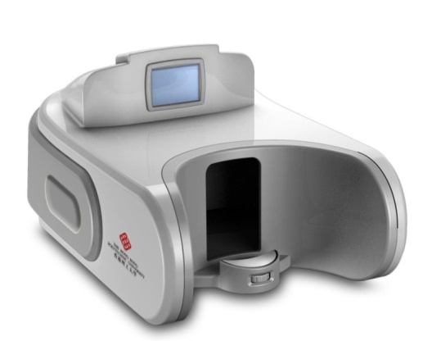
2. 生物特征识别与中医诊疗
代表成果（1）
舌相诊断
Innovation:
Image acquisition system of face/tongue.
System of “Tongue Diagnosis and Health Index”
Published the first paper of computerized diagnosis from tongue appearance. Introduced“Computerized Tongue Diagnosis”and“Traditional Chinese Medicine Modernization”
into IEEE/IEE key word list.
Publication :
1. Wang, XZ , et al. Statistical Analysis of Tongue Images for
Feature Extraction and Diagnostics, IEEE Transactions on
Image Processing，2013.
2. Wang, XZ , et al. A New Tongue Colorchecker Design by
Space Representation for Precise Correction. IEEE Journal
of Biomedical & Health Informatics , 2013.
Notes:
邬向前

Slide 19
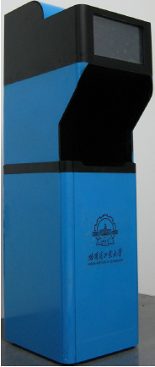
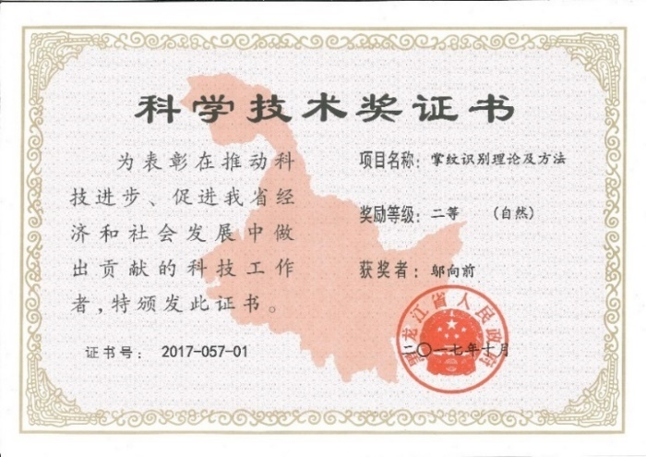
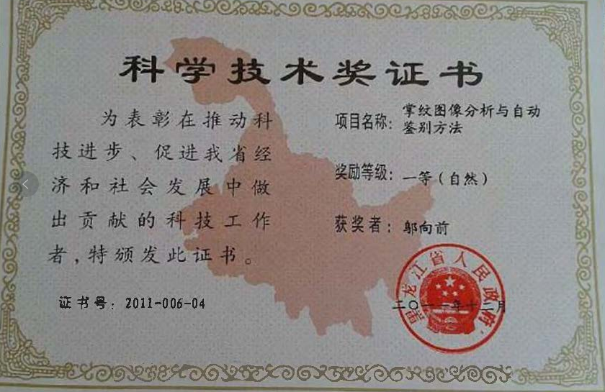
2. 生物特征识别与中医诊疗
代表成果（2）
掌纹识别系统
Innovation:
The first online plamprint recognition system in the world.
Effective, high accuracy, less affected by the external
environment, and not easily to be forged.
Award : The first (2011) and second (2017) prize in natural science
and technology of Heilongjiang Province
Publication
1. Wu, XQ et al. 1. Wang, XZ , et al. Deformed Palmprint
Matching Based on Stable Regions, IEEE Transactions
on Image Processing，2015.
Notes:
Published more than 100 papers in peer-reviewed journals, e.g. IEEE TIP, PR.
Obtained 12 patents from the United States, Hong Kong SAR, and China Mainland.
Published the first monograph about palmprint recognition in China.

Slide 20
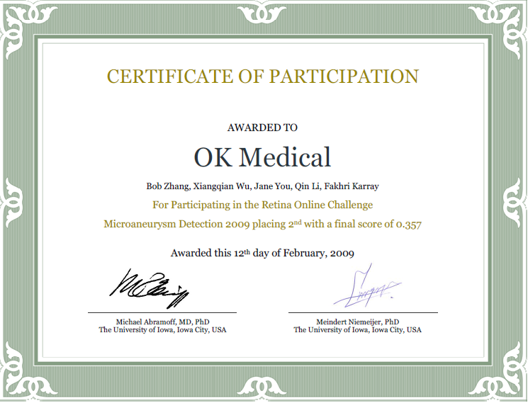
2. 生物特征识别与中医诊疗
代表成果（3）
视网膜检测系统
Innovation:
The first online diagnosis system of retinopathy lesions in China.
Precisely localized and segmented normal physiological structure on retina and automatically detected retinopathy.
Award : The second prize in the Retinopathy Online Challenge in 2009.
Publication :
1. Wu, XQ et al. Optic Disc Localization Using Directional Models, IEEE Transactions on Image Processing，2015.
Notes:
邬向前Published papers in some top journals, e.g. IEEE TIP, Pattern Recognition and PLOS ONE.

Slide 21
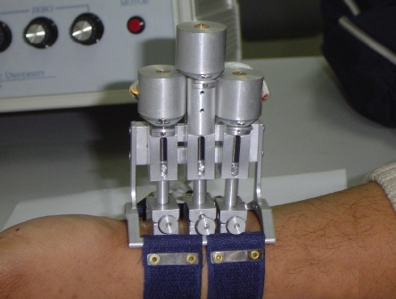
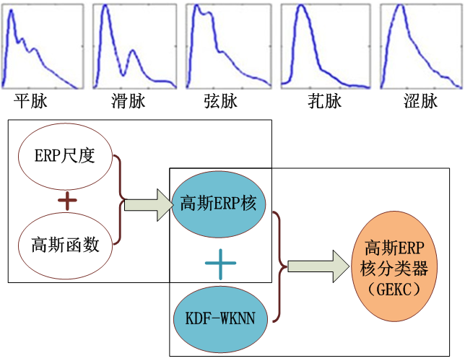
2. 生物特征识别与中医诊疗
代表成果（4）
脉搏诊断
Innovation:
Pulse signal detector.
Precise positioning and classifying pulse signals.
Publication :
1. Wang, P., et al. A Compound Pressure Signal Acquisition System for Multichannel Wrist Pulse Signal Analysis, IEEE Transactions on Instrumentation and Measurement，2014.
2. Liu, L., et al. Combination of heterogeneous features for wrist pulse blood flow signal diagnosis via multiple kernel learning. IEEE Transactions on Information Technology in BioMedicine , 2012.
Notes:
邬向前Published papers in some top journals, e.g. IEEE TIP, Pattern Recognition and PLOS ONE.

Slide 22
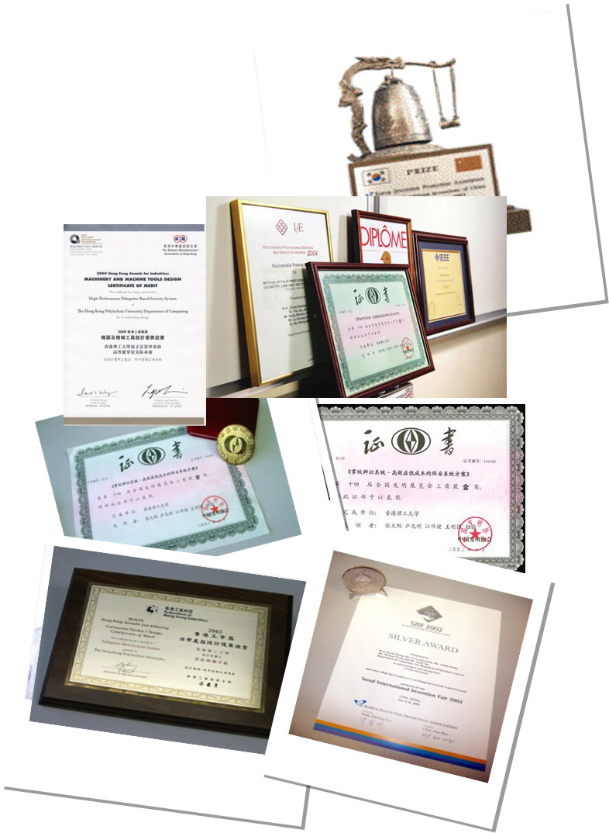
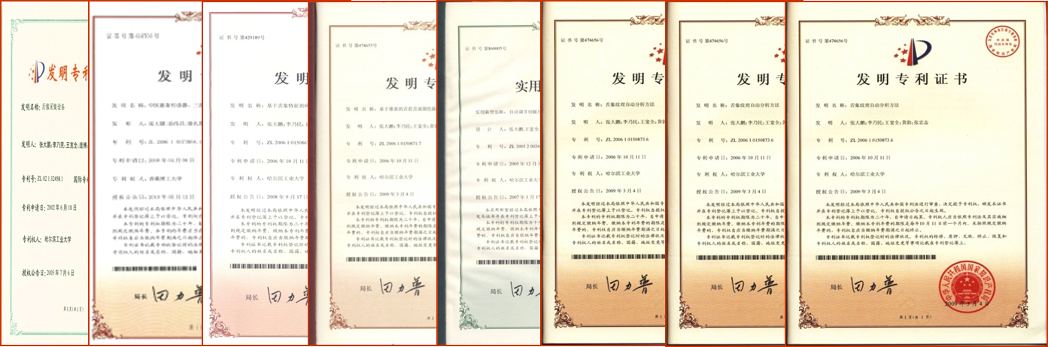
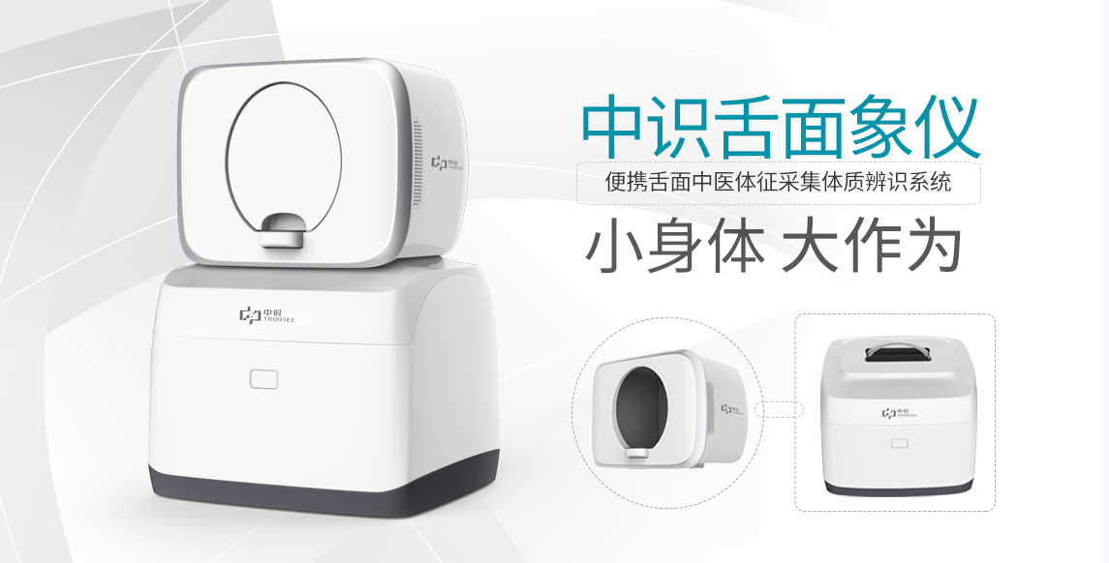
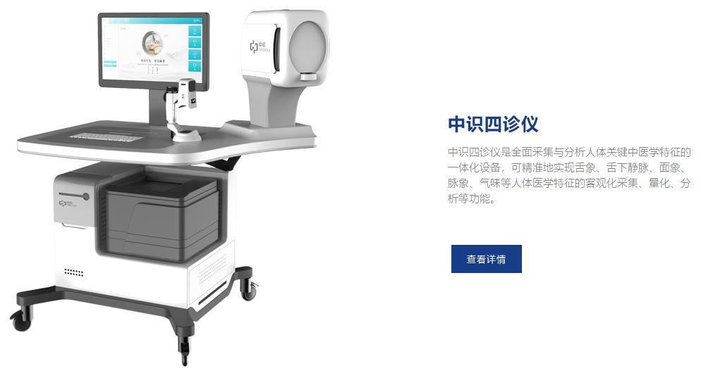

2. 生物特征识别与中医诊疗
Patents and Awards
Obtained 69 patents from US, HK, and China Mainland
Obtained more then 6 domestic and international awards.
Application
Collaborate on TCM diagnosis with TRONSEE at Shenzhen
Notes:
邬向前Published papers in some top journals, e.g. IEEE TIP, Pattern Recognition and PLOS ONE.

